Slide 1

DX University
Bryce Canyon, UT – 2012

Slide 2
How to Build a DXing Station - Antennas
Mike Fulcher KC7V

Slide 3
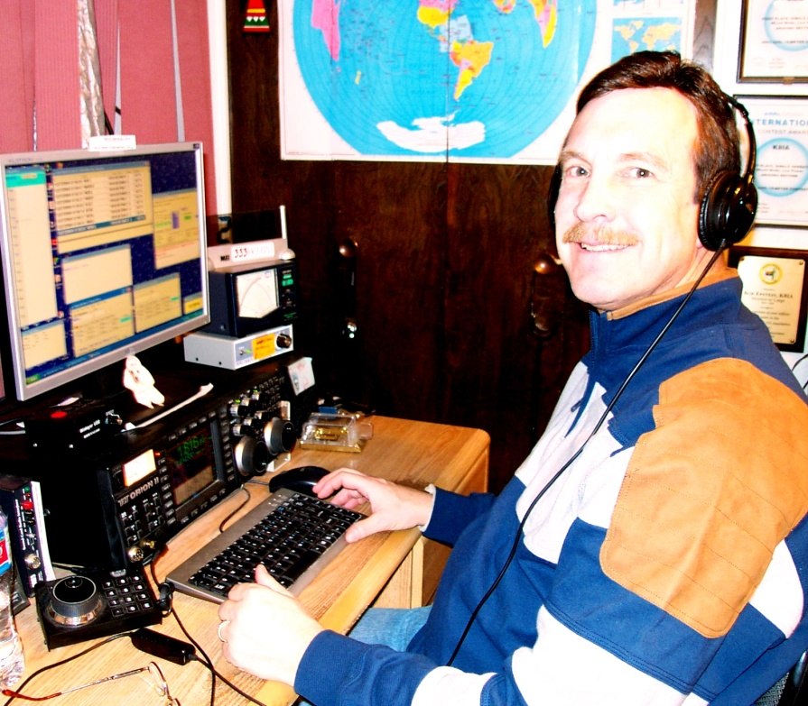
Mike Fulcher KC7V
First licensed in 1972 as WN9IXO. Has held many interesting calls and operated from 36 entities and 21 Zones.
Founding member of the VooDoo Contest Group. Member of FOC. Member and past President of CADXA. Founding member of the Arizona Outlaws Contesting Club.
Referee at WRTC in 1996 and 2006.

Slide 4
How to Build a DXing Station - Antennas
  Start with the end in mind
  Plot out on paper
  Budget Concerns
  What are you able to do physically?
  Put as much investment in antennas as you can!
  It’s a challenge and a lot of fun!

Slide 5
How to Build a DXing Station – Antennas
Requirements related to effective DXing
  Pattern matching propagation path to DX
  Pattern reducing effects of interference
  Efficiency
General characteristics
  Efficient antennas are likely to be narrowband
  Antennas are the best investment in your station
  Reliability can be more important than performance
  Higher antennas work DX better than lower ones

Slide 6
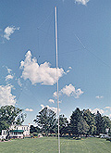
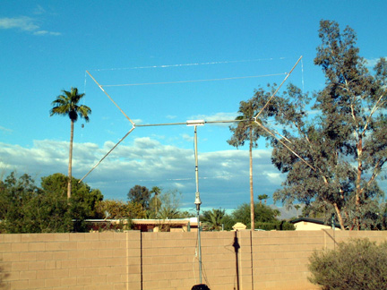
How to Build a DXing Station – Antennas
Low frequencies antennas (160 & 80 m)
Transmit antennas
    Verticals
    Dipoles (as high as possible)
Receive antennas
    Beverages
    Loops (ground-dependent antennas)
    Flag/pennants (ground-independent antennas)
    4-square short verticals

Slide 7
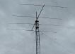
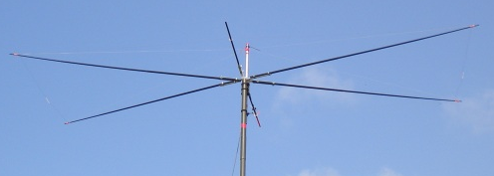
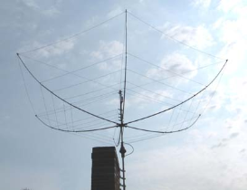
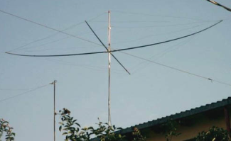
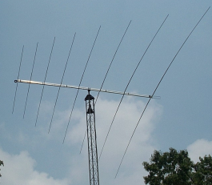
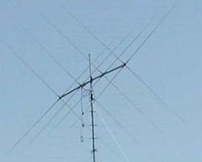
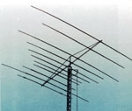
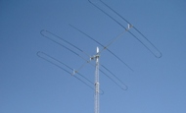
How to Build a DXing Station – Antennas
Antennas - HF
Monoband antennas
  Full size: Yagi¹
  Shortened: Moxon²
Multi-band antennas
  Fixed
    Hexbeam¹ Quad⁴
    Spider beam² Multiband yagi⁵
    Log periodic³
  Adjustable
    StepIR
1
2
1
2
3
4
5

Slide 8
How to Build a DXing Station - Antennas
Low Budget
  Wire, even very small diameter
  Dipoles, single band or fan
  Vertical, used market
  Portable antennas
  HOA? – attic antenna, paint and fake ivy
  Be creative, you will work stations

Slide 9
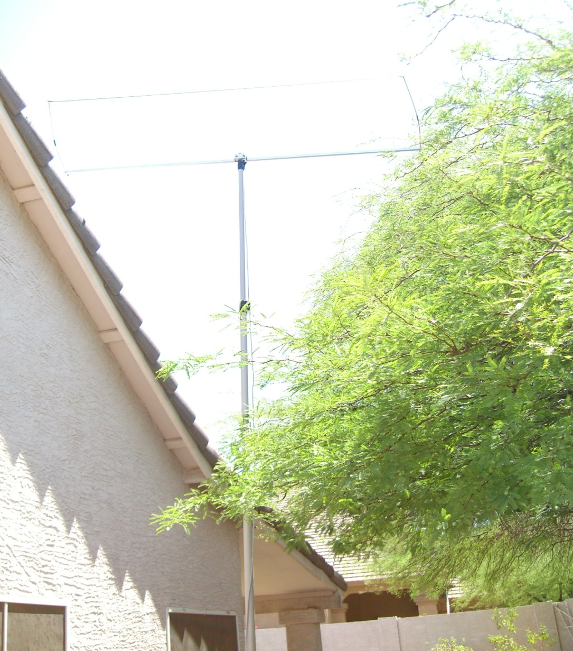
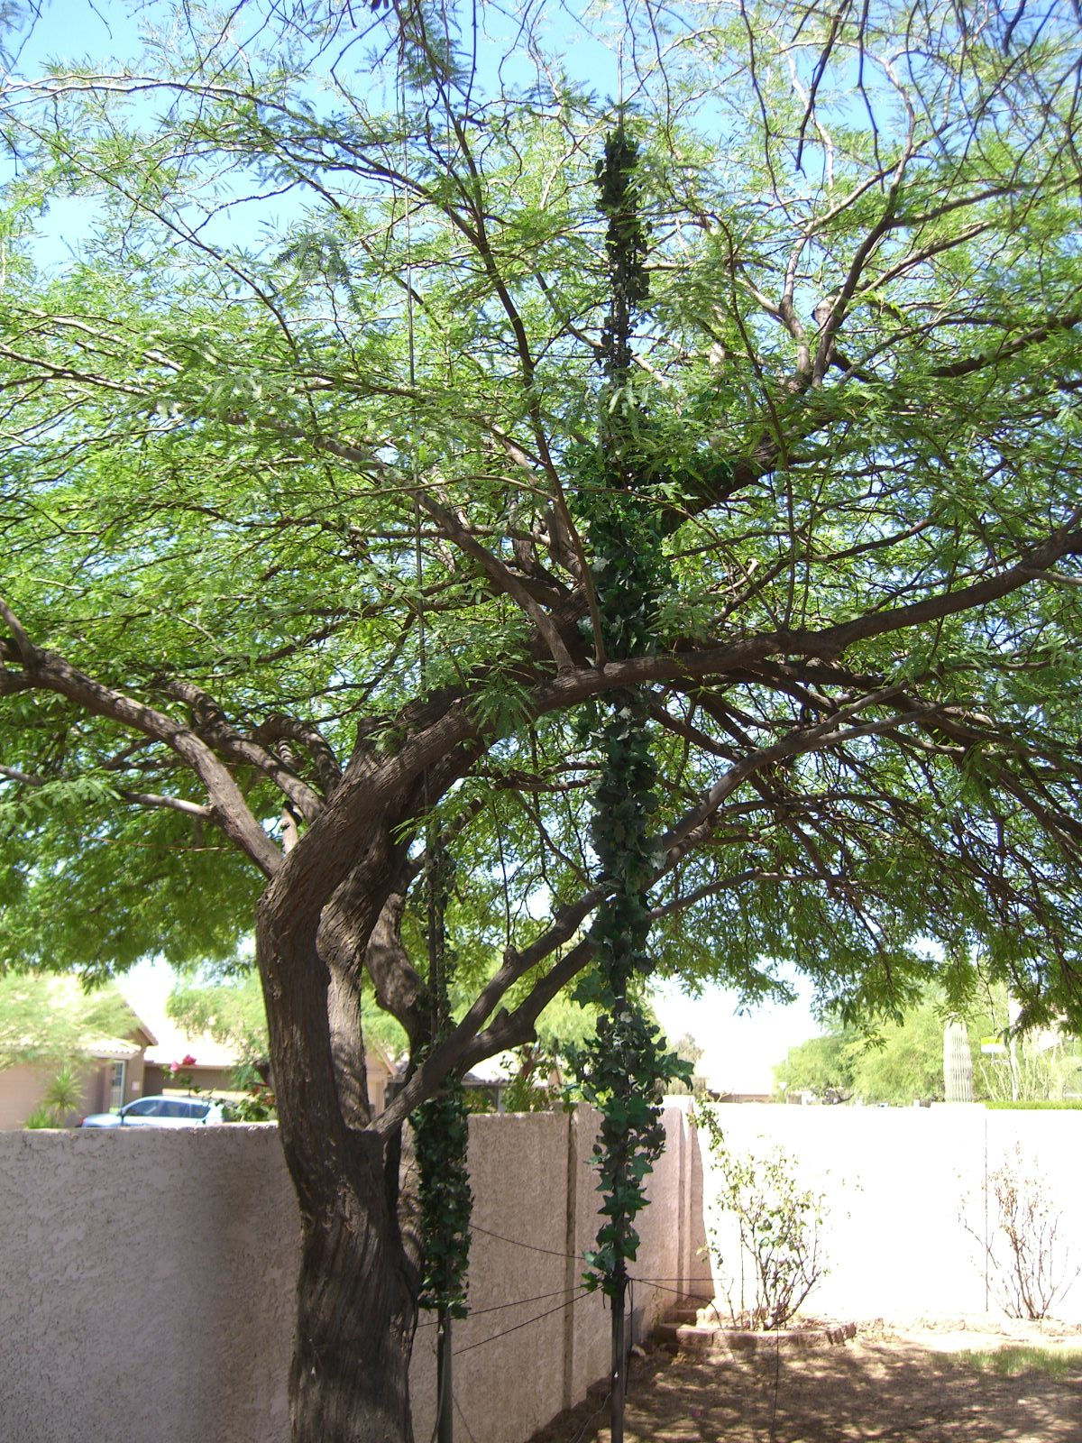
How to Build a DXing Station - Antennas
Low Budget

Slide 10
How to Build a DXing Station - Antennas
Medium Budget
  Tower
  Crank up or Guyed
  Tribander, Smaller Monobanders
  Preferably 50 to 70 feet
  Wires for low bands

Slide 11
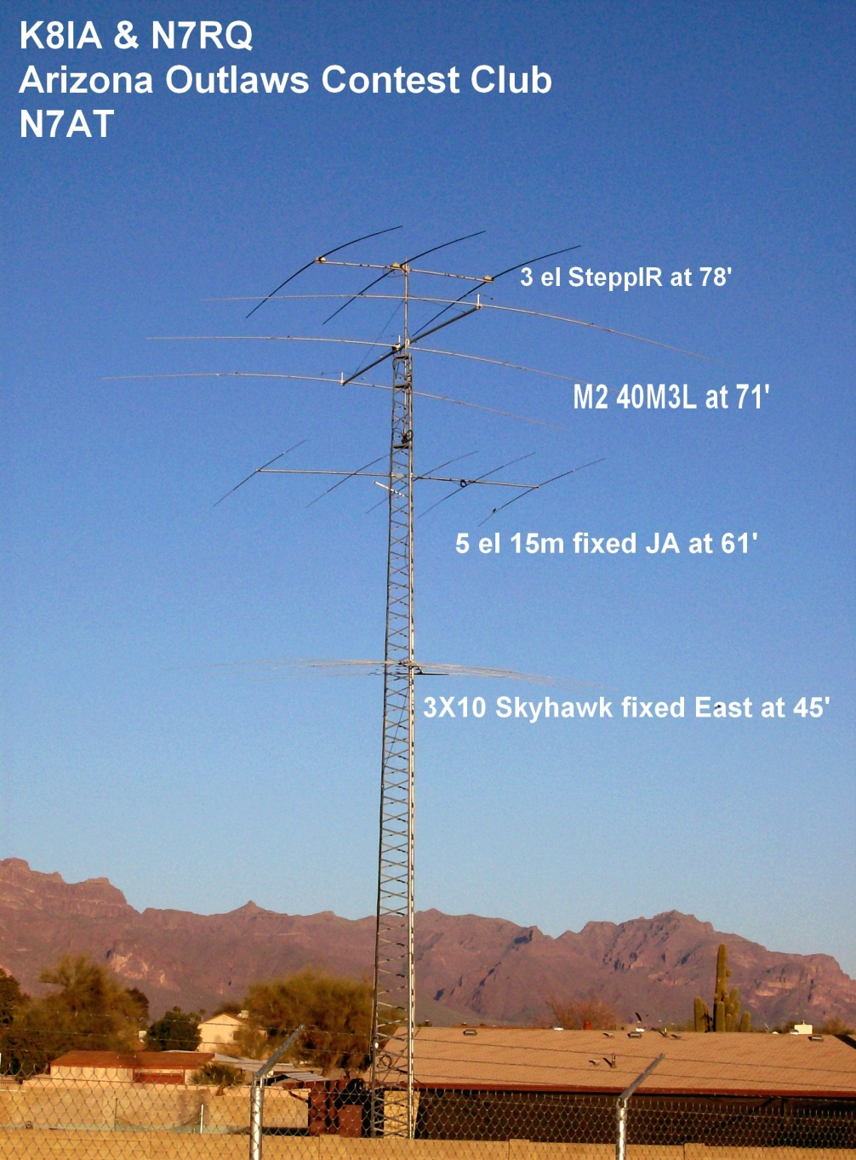
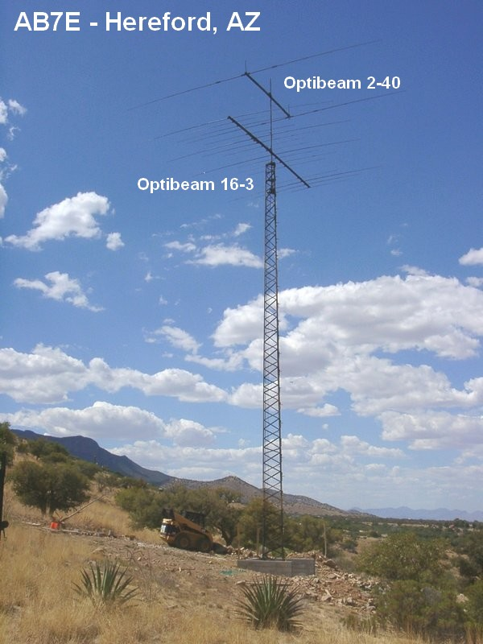
How to Build a DXing Station - Antennas
Medium Budget

Slide 12
How to Build a DXing Station - Antennas
Mega Budget
  Multiple Tall Towers
  Big Monobanders
  Fixed Yagis in key directions
  Stacked yagis for gain and elevation fills
  Preferably 100 to 200 feet
  Monobanders for 40m and even 80m

Slide 13
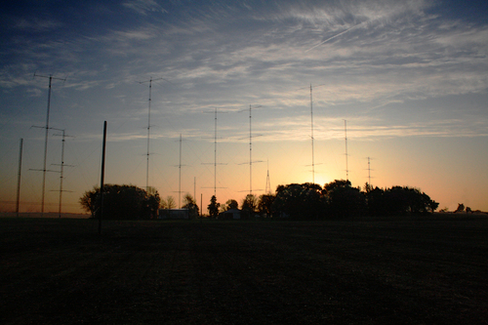
How to Build a DXing Station - Antennas
Big Gun USA…N0NI

Slide 14
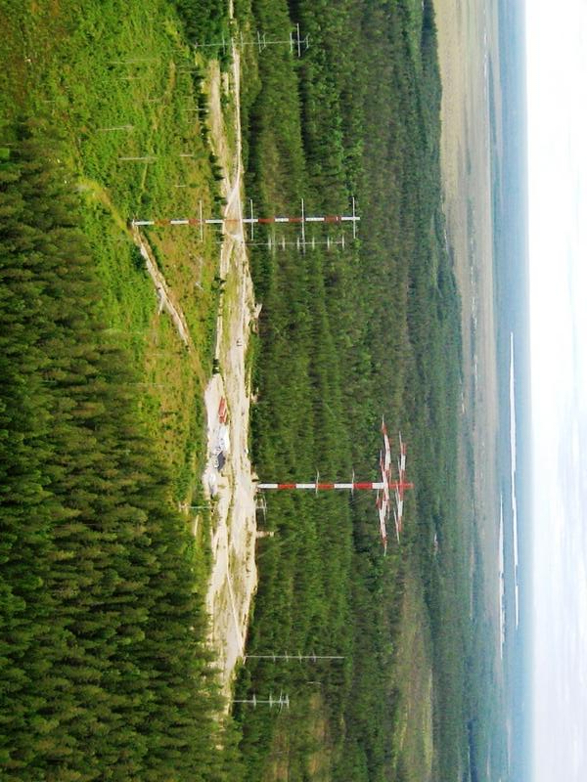
How to Build a DXing Station - Antennas
Big Gun..OH8X etc

Slide 15
How to Build a DXing Station - Antennas
  Take advantage of tools available
  HFTA – High Frequency Terrain Analysis – ARRL Antenna Handbook
  Low Band DXing
  Grayline Maps
  Study Arrival Angles
  Antenna modeling tools like EZNEC

Slide 16
How to Build a DXing Station - Antennas
  Resonant antennas better
  You can get many things to work with tuners
  Creativity gets you on the air
  Plan ahead and get help
  Make noise on the bands

Slide 17
How to Build a DXing Station - Antennas
Loud is Good
Louder is Better!!

